Slide 1

Airbnb E-Business and Mobile Business
Assignment 2
Jaime Ramirez
Cüneyt Fedakar
Mathieu Le Douairon
Pasquale Biafora

Slide 2

Agenda
Airbnb
Value Proposition
Value Chain and Involved Parties
Value and Costs Drivers
Value Process Framework
Questions

Slide 3

Airbnb
Nearly 5 million
Airbnb listings worldwie
81`000 citis list homes with Airbnb
191+
Countries have Airbnb listings
300 million+
Airbnb guests arrivals all-time
Notes:
Foundation Year: August 2008 in San Francisco
Airbnb is a community-based online platform for listing and renting local homes. It connects hosts and travelers and facilitates the process of renting without owning any rooms itself. Moreover it cultivates a sharing-economy by allowing property owners to rent out private flats.

Slide 4
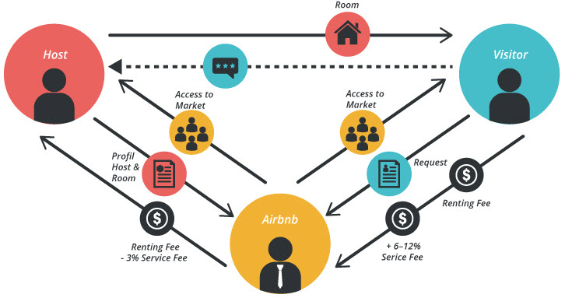
Value Proposition
For the hosts:
Income generation
Ease of transactions
Meeting new people
Ease of getting verified guests
Calendar, booking management
For the Guests:
Lower cost
Easy transactions
Authentical local experiance
More variety
Transparent ratings
Picture Source: https://bmtoolbox.net/stories/airbnb/

Slide 5

Value Chain and Involved Parties
App Installation
Host offerings
Traveler booking
Payment Service
Trust
Management
1. App Store & Google Chrome
2. Hosts & Traveler
1. Hosts
1. Traveler
1. Traveler 2. Hosts
1. Traveler 2. Hosts
Picture Source: Own Illustration

Slide 6
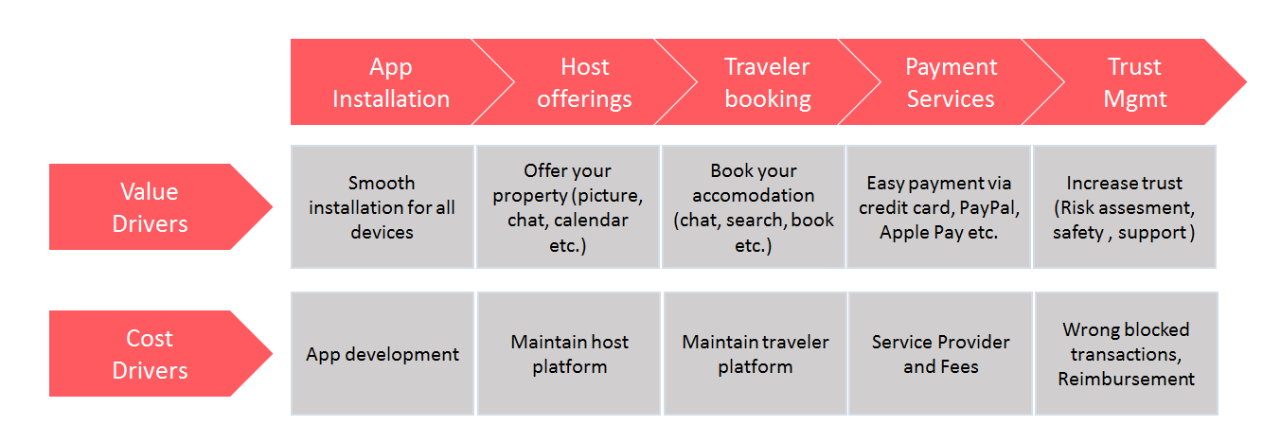
Value and Cost Drivers
Main Value drivers
Convenience
Match offer and demand
Usability
Main Cost drivers
Development (Human Capital)
Infrastructure Maintenance
Pay Service Provider
Picture Source: Own illustration

Slide 7
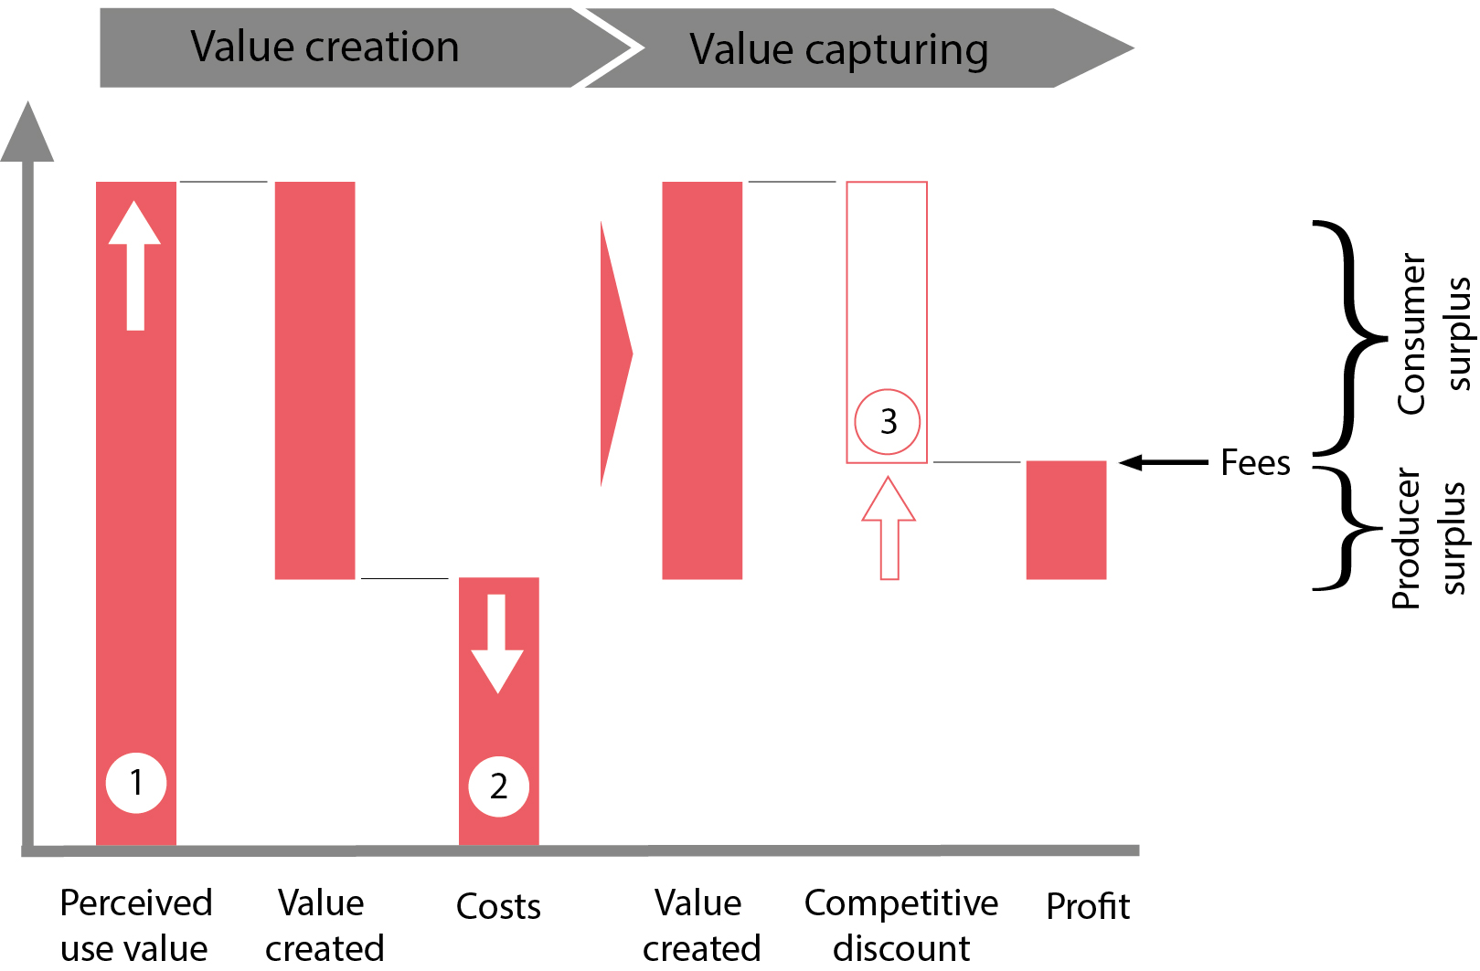
Value Process Framework
Perceived value for travelers and hosts are big
Costs consist mainly of app development and maintenance of the platforms
Barrier for new entrants is high, however, hotel sector is saturated
Picture source: Own Illustration

Slide 8

Questions

Slide 9

Thank you for your attention.

Slide 10
Source citation
All pictures are from: https://www.pexels.com/
All icons are from: https://www.flaticon.com/

